Slide 1
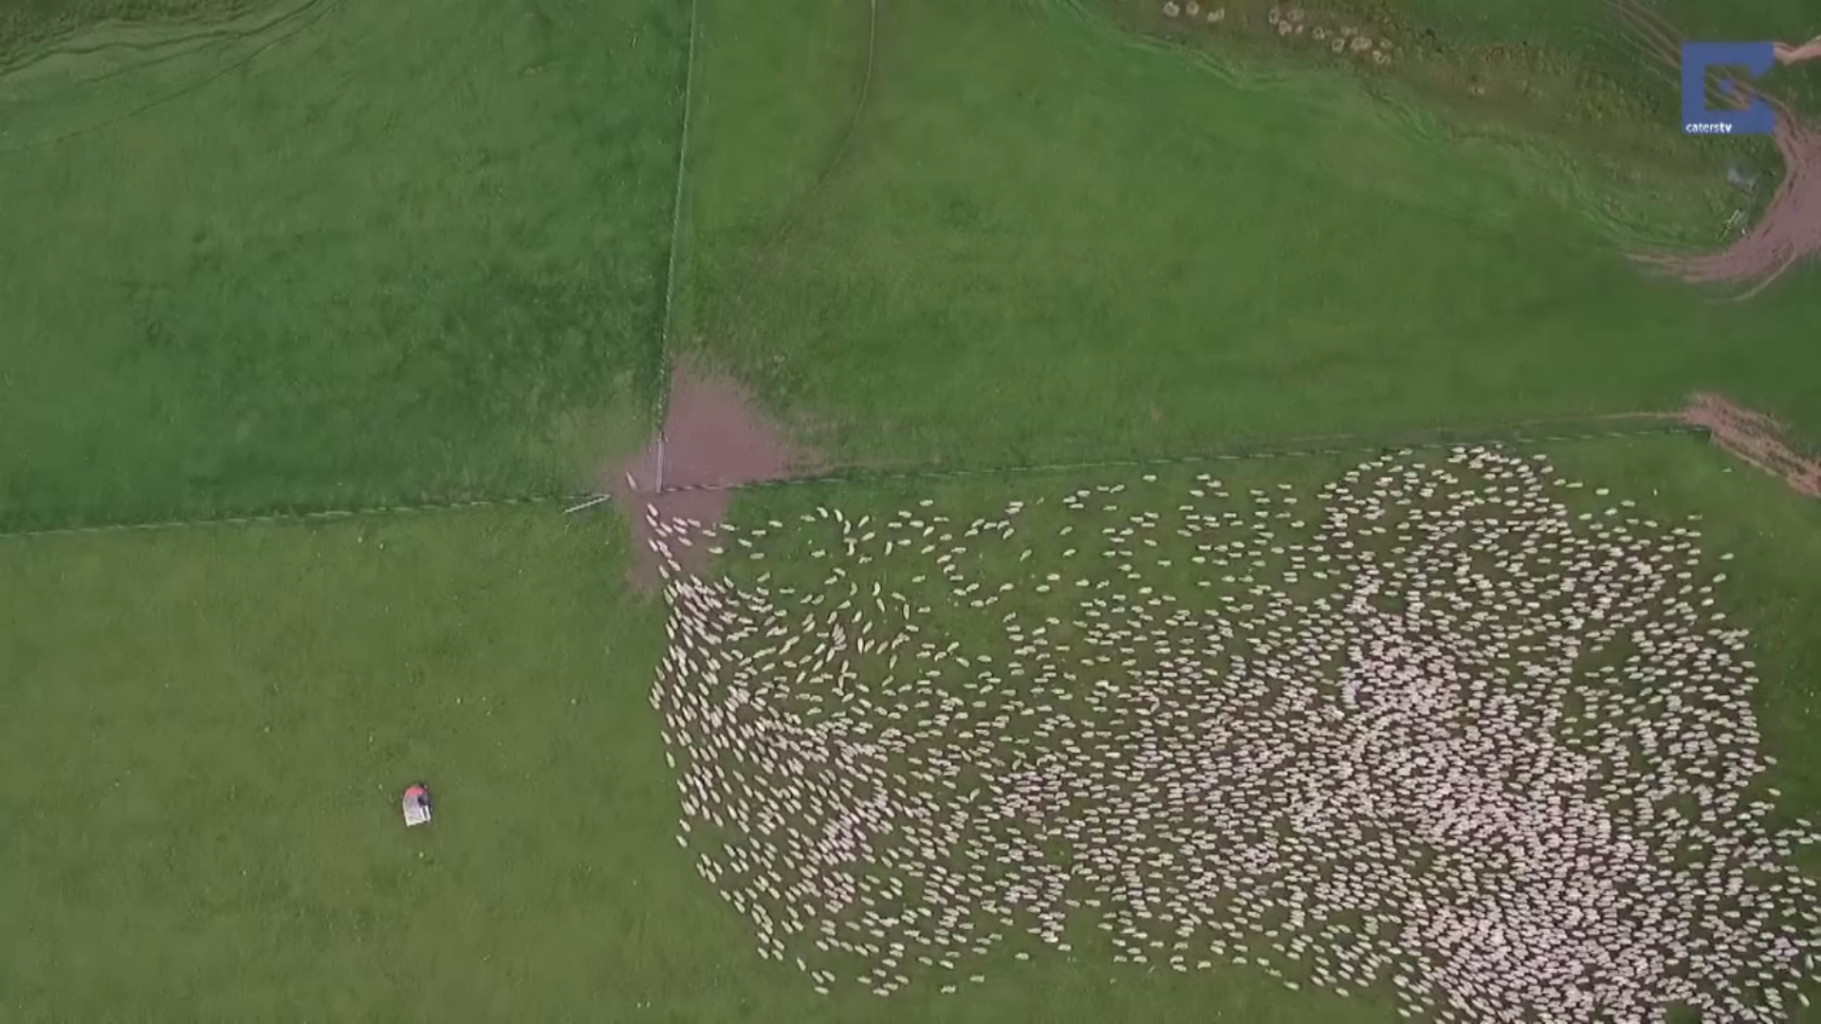
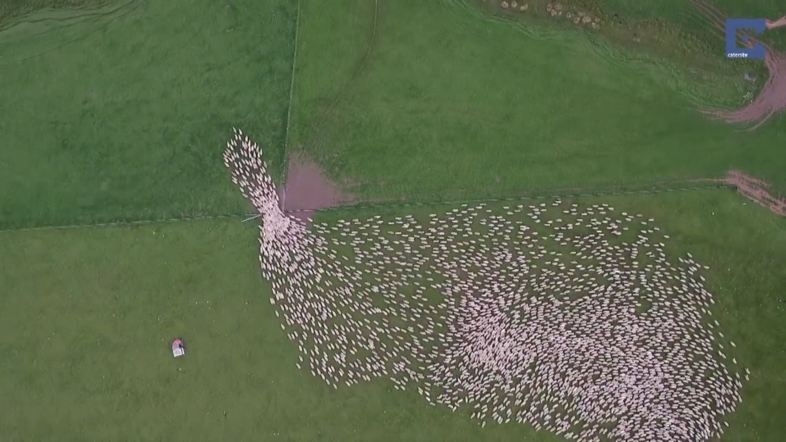
ECE 533 Final Project
Particle Flow
Jon Van Veen, Cristian Sanchez, Seunghyun Jeon, Brandon Krzyzanowski

Slide 2
Project Goals
Analyze particle flow across images using the movement of sheep through a small opening with Particle Image Velocimetry techniques
Determine appropriate density, resolution, and average velocity for the sheep to compute the average flow of sheep across all four given images

Slide 3
Introduction
Four steps: preprocessing, heat map, determining resolution, computing average velocities
Discussion, observations, conclusions for each step and the project

Slide 4
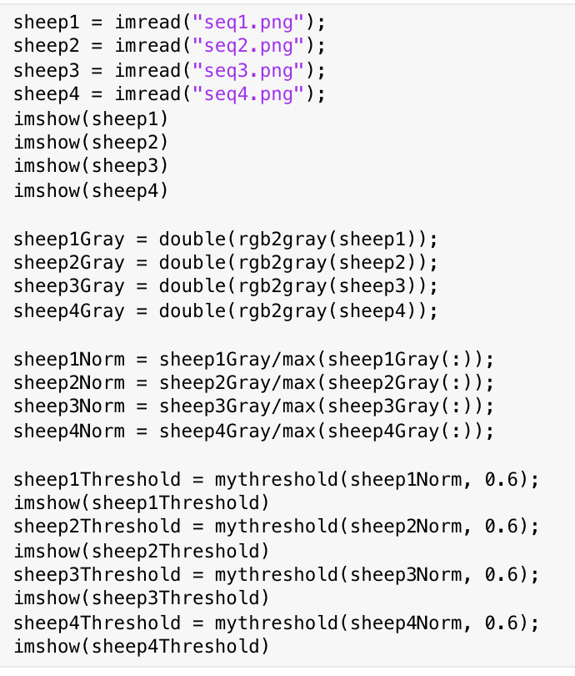
Step 1: Preprocessing of Images
Our preprocessing consists of standard steps, including normalization and converting image values to doubles
We threshold all four images in order to pick out distinct sheep for future particle flow analysis

Slide 5
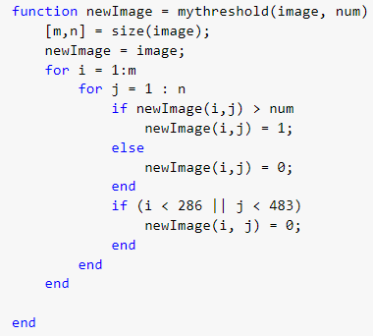
Thresholding
We threshold all four images in order to pick out distinct sheep for future particle flow analysis

Slide 6
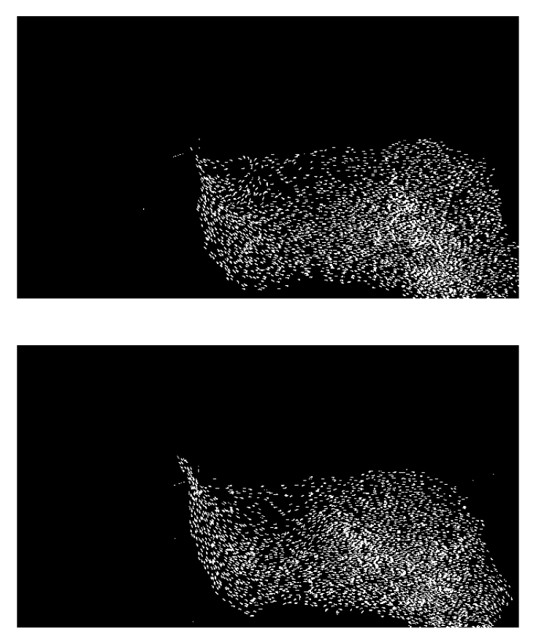
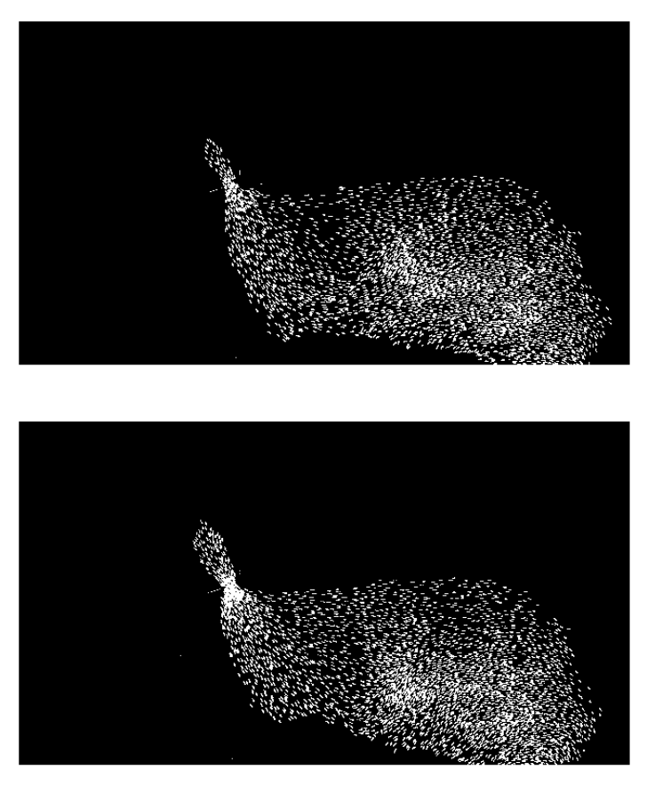
Step 1: Preprocessing of Images

Slide 7
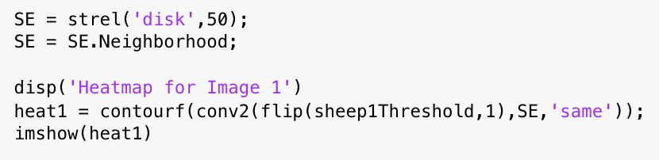
Step 2: Sheep “Heat Map”
We created a “heat map” for each frame in order to find the density of the sheep herd in each image
Used a disk of radius 50 as a structural element
Convoluted each thresholded image with the structural element
Had to flip due to the way convolution works in matlab
Created a contour map to show the density of the flock

Slide 8
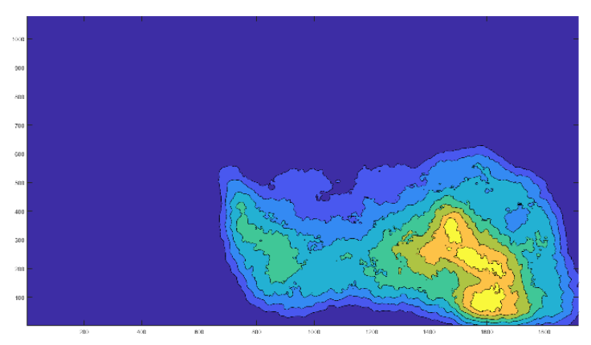
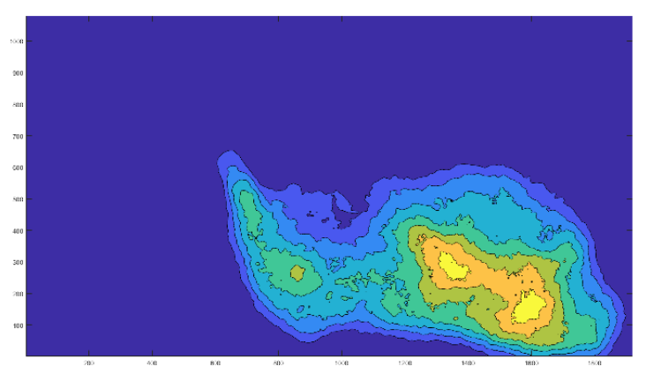
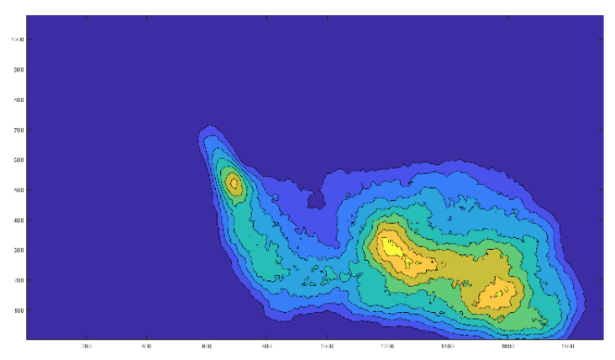
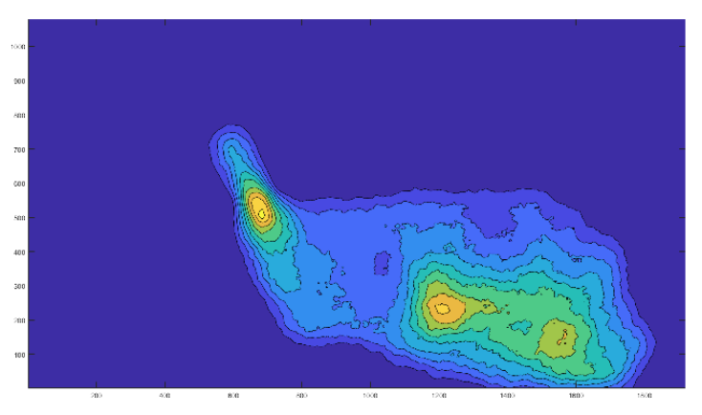
Step 2: Sheep “Heat Map” -- Results

Slide 9
Step 3: Determining Resolution

Slide 10
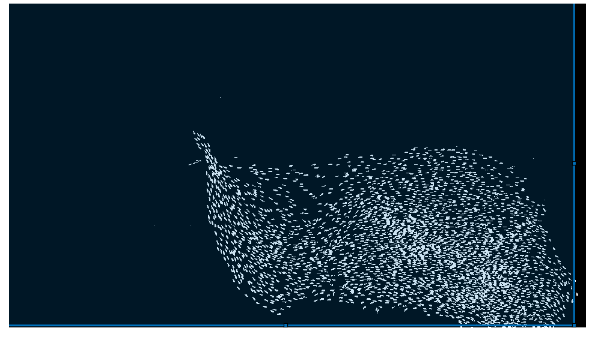
Step 3: Determining Resolution
First attempt at finding movement between frames
Searches over entire image
Shows overall movement up and to the left

Slide 11
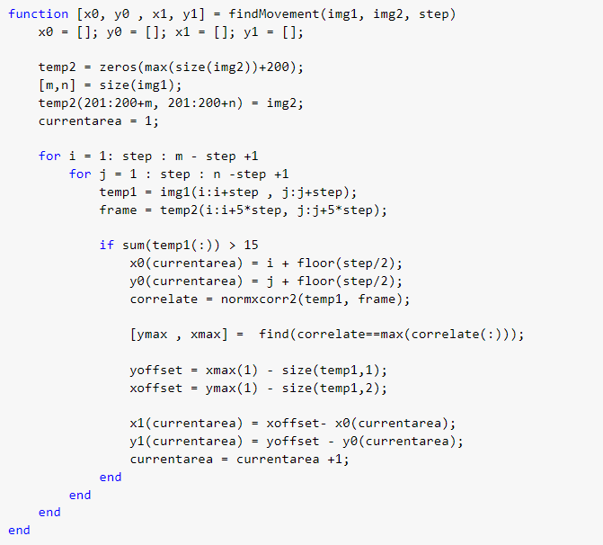
Step 3: Determining Resolution

Slide 12
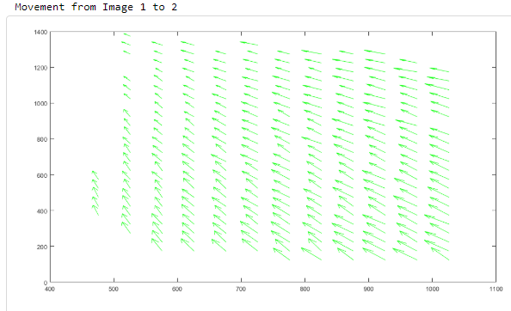
Step 3: Determining Resolution -- Results

Slide 13
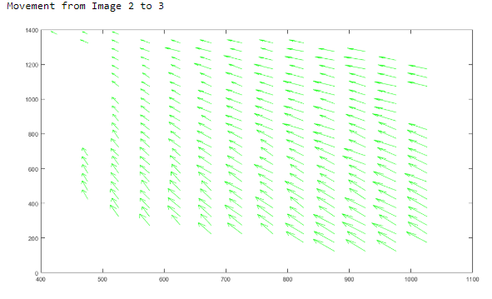
Step 3: Determining Resolution -- Results

Slide 14
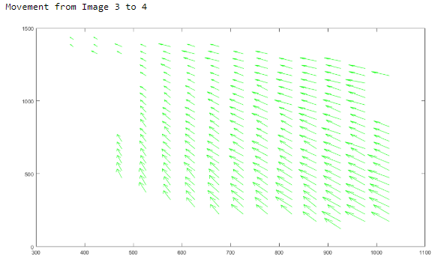
Step 3: Determining Resolution -- Results

Slide 15
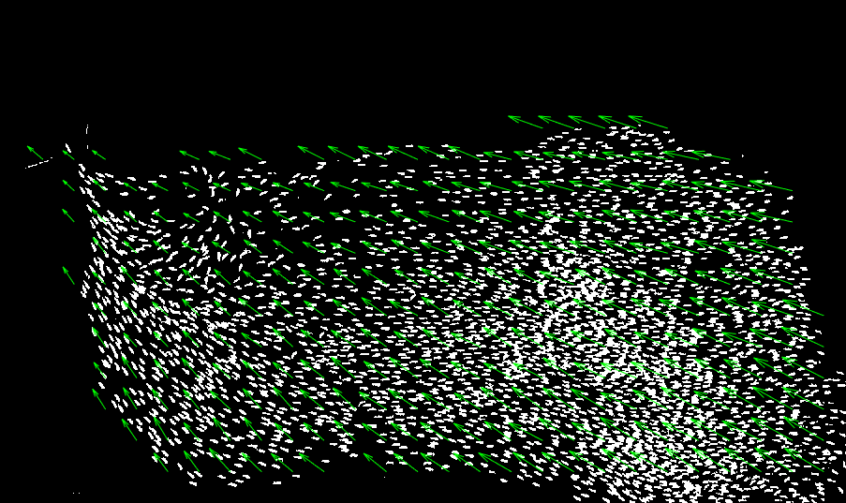
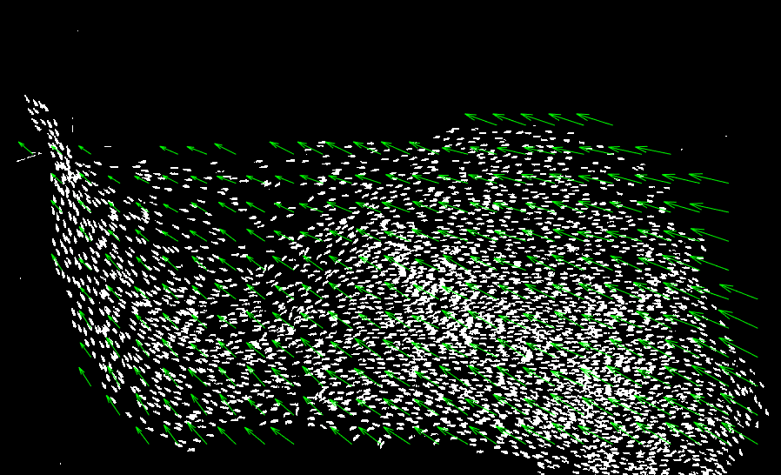
Step 3: Determining Resolution -- Results

Slide 16

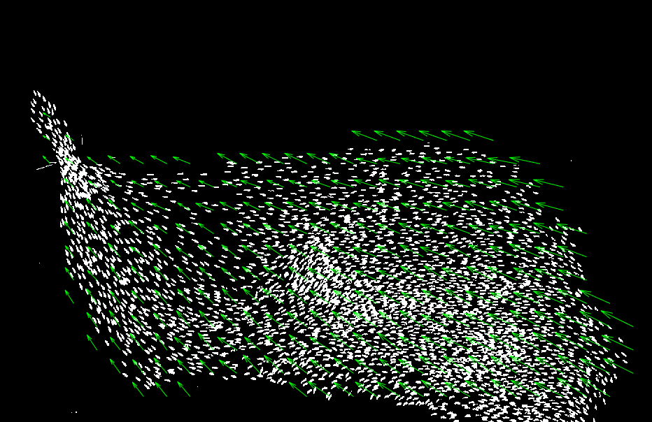
Step 3: Determining Resolution -- Results

Slide 17
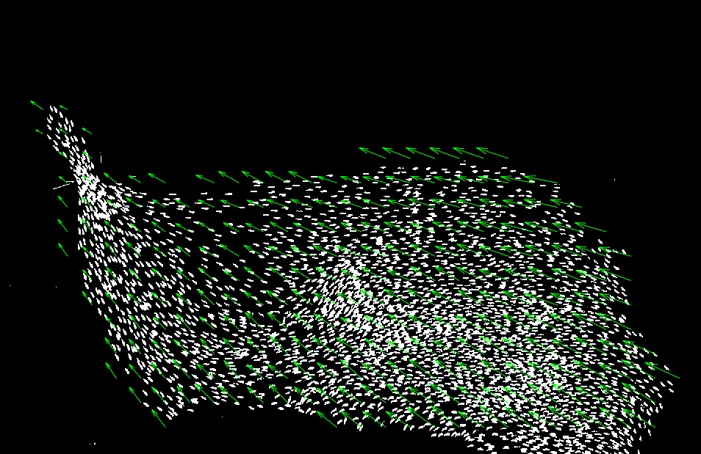
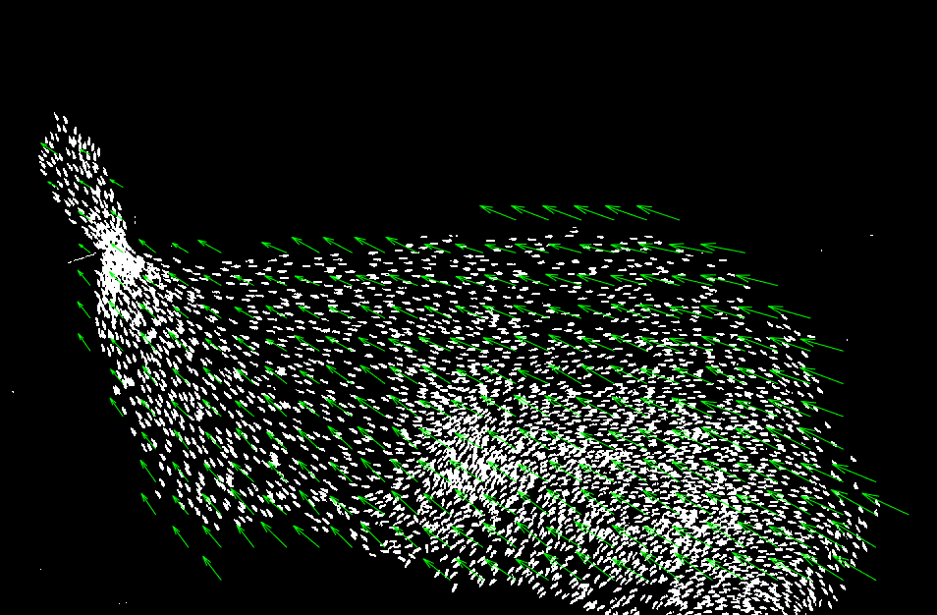
Step 3: Determining Resolution -- Results

Slide 18
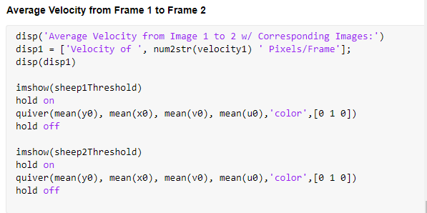
Step 3: Determining Resolution -- Results

Slide 19
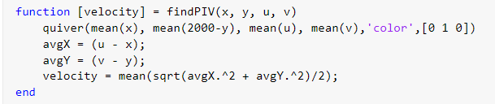
Step 4: Computing Average Velocity
findPIV function

Slide 20
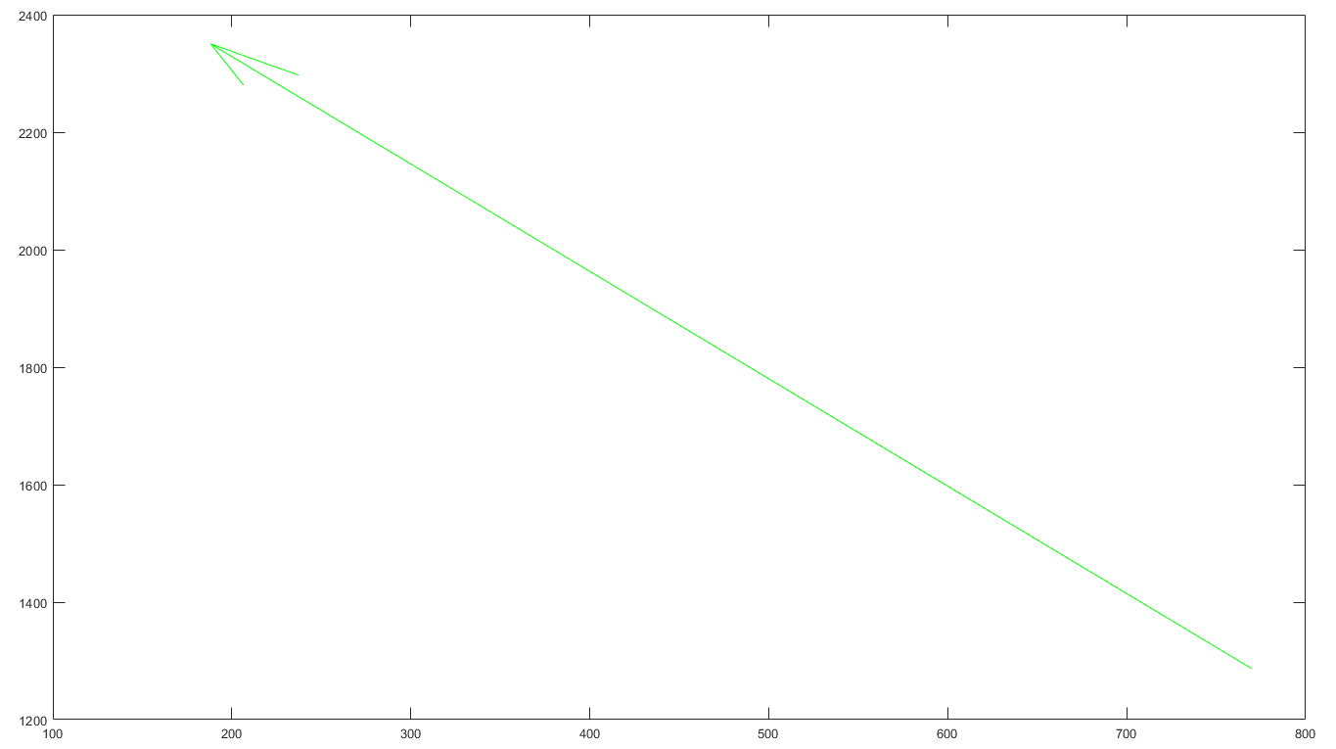
Average Velocity from Frame 1 to 2

Slide 21
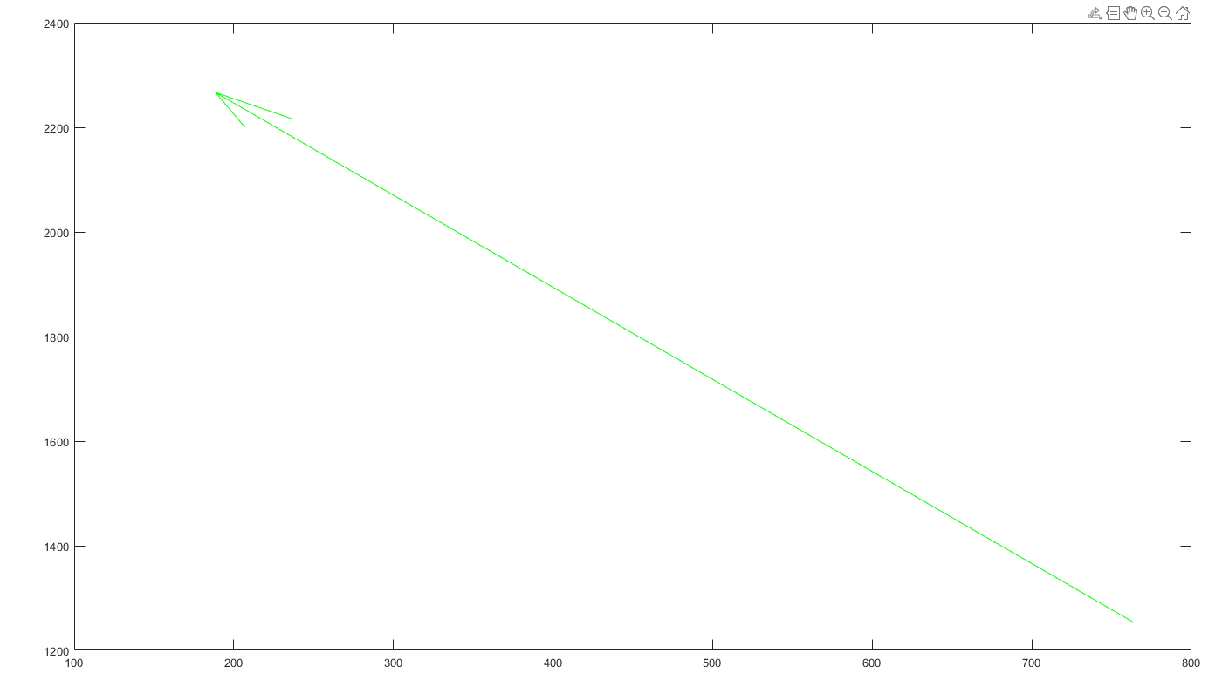
Average Velocity from Frame 2 to 3

Slide 22
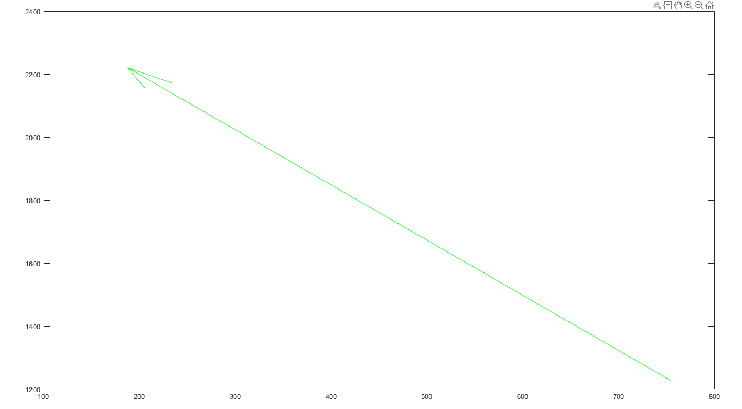
Average Velocity from Frame 3 to 4

Slide 23
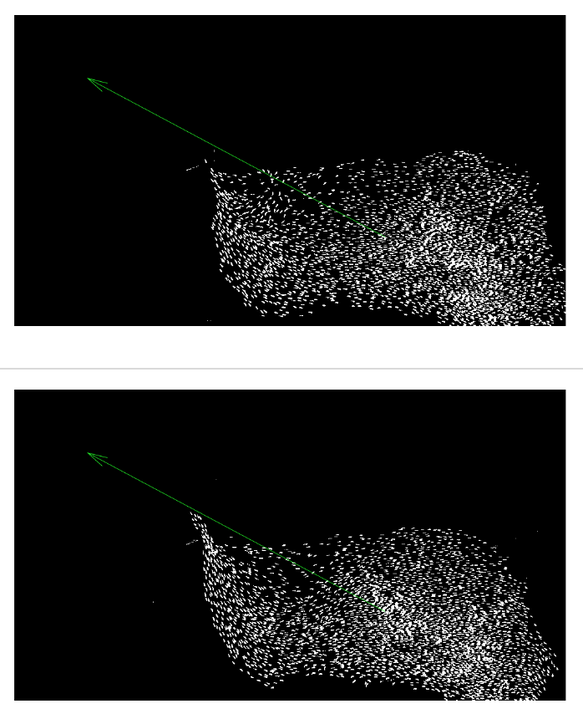
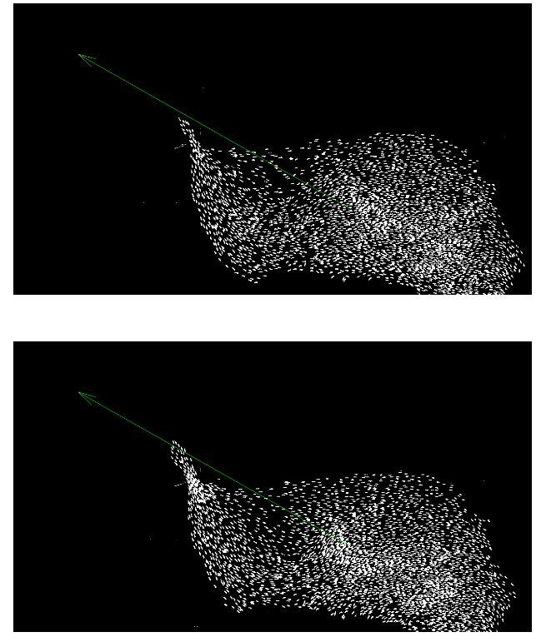
Step 4: Computing Average Velocities -- Results

Slide 24
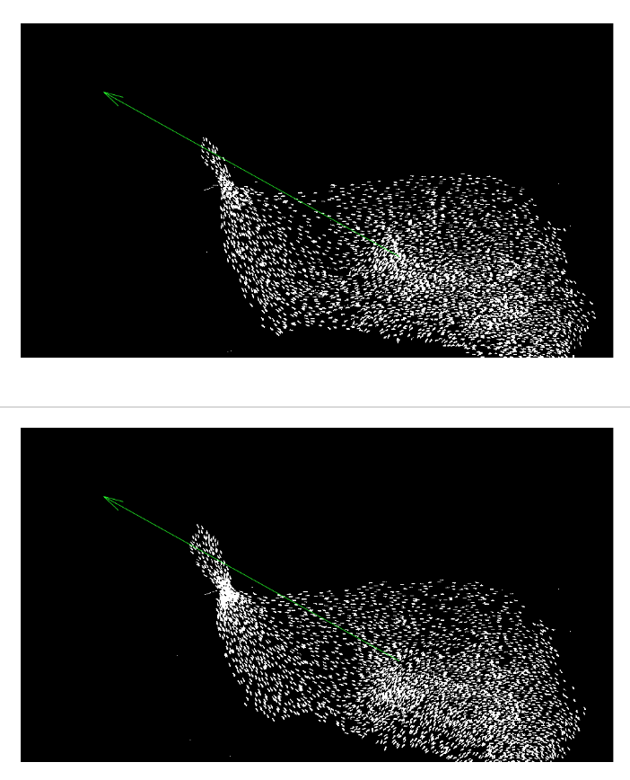
Step 4: Computing Average Velocities -- Results

Slide 25
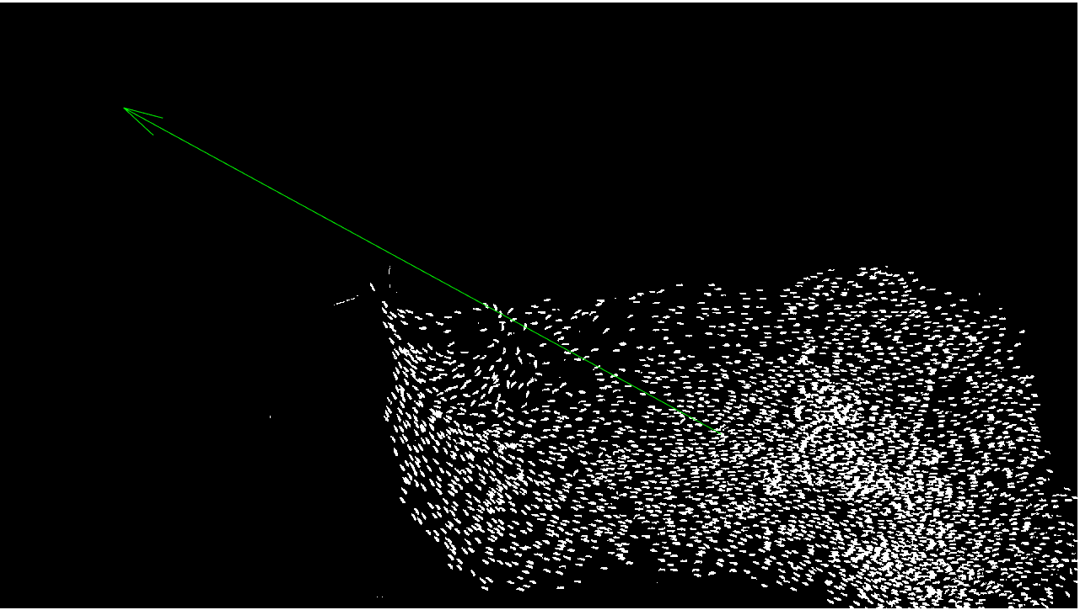
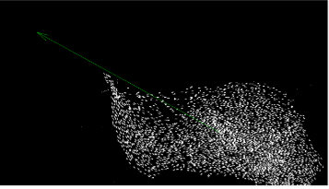
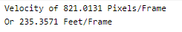
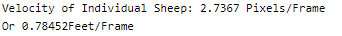
Average Velocity Overlayed

Slide 26
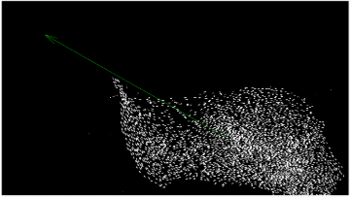
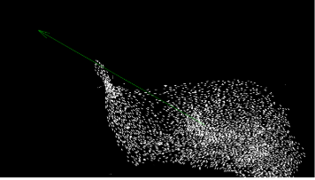
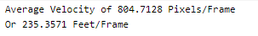
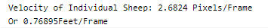
Average Velocity Overlayed

Slide 27
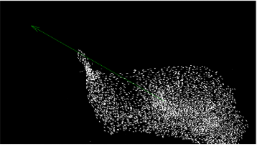
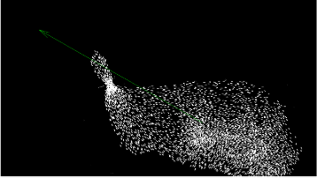
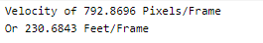
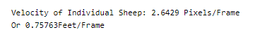
Average Velocity Overlayed

Slide 28
Final Observations and Conclusion
There are several different ways to solve this problem, but we believe we achieved good results with the methods we used
This was a difficult but engaging project, and gave a taste of how PIV is applied in engineering

